Slide 1
Planning Tools and Techniques
Chapter
9

Slide 2
L E A R N I N G O U T L I N E
Follow this Learning Outline as you read and study this chapter.
Techniques for Assessing the Environment
  List the different approaches to assess the environment.
  Explain what competitor intelligence is and ways that managers can do it legally and ethically.
  Describe how managers can improve the effectiveness of forecasting.
  List the steps in the benchmarking process.
Techniques for Allocating Resources
  List the four techniques for allocating resources.
  Describe the different types of budgets.
  Explain what a Gantt chart and a load chart do.

Slide 3
L E A R N I N G O U T L I N E (cont’d)
Follow this Learning Outline as you read and study this chapter.
Techniques for Allocating Resources (cont’d)
  Describe how PERT network analysis works.
  Understand how to compute a breakeven point.
  Describe how managers can use linear programming.
Contemporary Planning Techniques
  Explain why flexibility is so important to today’s planning techniques.
  Describe project management.
  List the steps in the project planning process.
  Discuss why scenario planning is an important planning tool.

Slide 4
Assessing the Environment
Environmental Scanning
  The screening of large amounts of information to anticipate and interpret change in the environment.
  Competitor Intelligence
    The process of gathering information about competitors—who they are; what they are doing
      Is not spying but rather careful attention to readily accessible information from employees, customers, suppliers, the Internet, and competitors themselves.
    May involve reverse engineering of competing products to discover technical innovations.

Slide 5

Assessing the Environment (cont’d)
Environmental Scanning (cont’d)
  Global Scanning
    Screening a broad scope of information on global forces that might affect the organization.
    Has value to firms with significant global interests.
    Draws information from sources that provide global perspectives on world-wide issues and opportunities.

Slide 6

Assessing the Environment (cont’d)
Forecasting
  The part of organizational planning that involves creating predictions of outcomes based on information gathered by environmental scanning.
    Facilitates managerial
    decision making.
    Is most accurate in
    stable environments.

Slide 7

Assessing the Environment (cont’d)
Forecasting Techniques
  Quantitative forecasting
    Applying a set of mathematical rules to a series of hard data to predict outcomes (e.g., units to be produced).
  Qualitative forecasting
    Using expert judgments and opinions to predict less than precise outcomes (e.g., direction of the economy).
Collaborative Planning, Forecasting, and Replenishment (CPFR) Software
  A standardized way for organizations
  to use the Internet to exchange data.

Slide 8
Exhibit 9–1 Forecasting Techniques
Quantitative
  Time series analysis
  Regression models
  Econometric models
  Economic indicators
  Substitution effect
Qualitative
  Jury of opinion
  Sales force composition
  Customer evaluation

Slide 9
Making Forecasting More Effective
Use simple forecasting methods.
Compare each forecast with its corresponding “no change” forecast.
Don’t rely on a single forecasting method.
Don’t assume that the turning points in a trend can be accurately identified.
Shorten the time period covered by a forecast.
Remember that forecasting is a developed managerial skill that supports decision making.

Slide 10

Benchmarking
The search for the best practices among competitors and noncompetitors that lead to their superior performance.
By analyzing and copying these practices, firms can improve their performance.

Slide 11
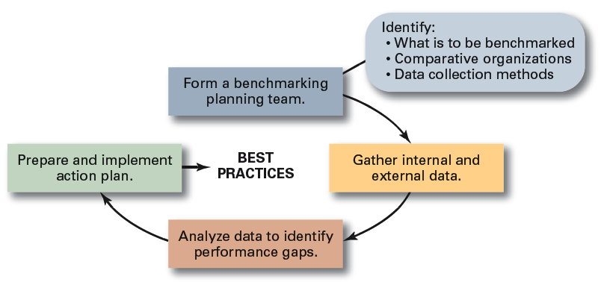
Exhibit 9–2 Steps in Benchmarking
Source: Based on Y.K. Shetty, “Aiming High: Competitive Benchmarking for Superior Performance,” Long Range Planning. February 1993, p. 42.

Slide 12
Allocating Resources
Types of Resources
  The assets of the organization
    Financial: debt, equity, and retained earnings
    Physical: buildings, equipment, and raw materials
    Human: experiences, skills, knowledge, and competencies
    Intangible: brand names, patents, reputation, trademarks, copyrights, and databases

Slide 13

Allocating Resources: Budgeting
Budgets
  Are numerical plans for allocating resources (e.g., revenues, expenses, and capital expenditures).
  Are used to improve time, space, and use of material resources.
  Are the most commonly used
  and most widely applicable
  planning technique for
  organizations.

Slide 14
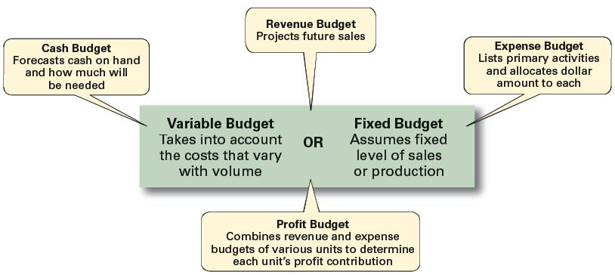
Exhibit 9–3 Types of Budgets
Source: Based on R.S. Russell and B.W. Taylor III. Production and Operations Management (Upper Saddle River, NJ: Prentice Hall, 1995), p. 287.

Slide 15
Exhibit 9–4 Suggestions for Improving Budgeting
Collaborate and communicate.
Be flexible.
Goals should drive budgets—budgets should not determine goals.
Coordinate budgeting throughout the organization.
Use budgeting/planning software when appropriate.
Remember that budgets are tools.
Remember that profits result from smart management, not because you budgeted for them.

Slide 16

Allocating Resources: Scheduling
Schedules
  Plans that allocate resources by detailing what activities have to be done, the order in which they are to be completed, who is to do each, and when they are to be completed.
  Represent the coordination of various activities.

Slide 17
Allocating Resources: Charting
Gantt Chart
  A bar graph with time on the horizontal axis and activities to be accomplished on the vertical axis.
  Shows the expected and actual progress of various tasks.
Load Chart
  A modified Gantt chart that lists entire departments or specific resources on the vertical axis.
  Allows managers to plan and control capacity utilization.

Slide 18
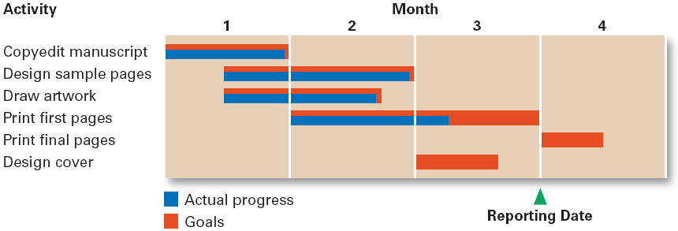
Exhibit 9–5 A Gantt Chart

Slide 19
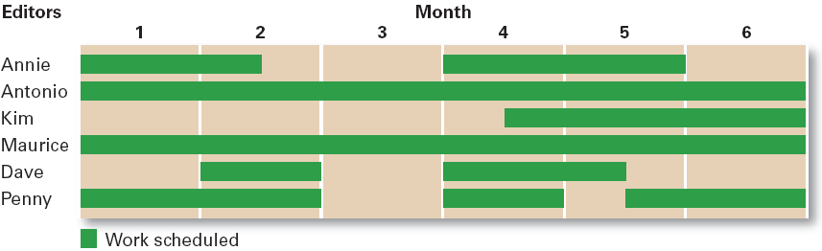
Exhibit 9–6 A Load Chart

Slide 20
Allocating Resources: Analysis
Program Evaluation and Review Technique (PERT)
  A flow chart diagram that depicts the sequence of activities needed to complete a project and the time or costs associated with each activity.
    Events: endpoints for completion.
    Activities: time required for each activity.
    Slack time: the time that a completed activity waits for another activity to finish so that the next activity, which depends on the completion of both activities, can start.
    Critical path: the path (ordering) of activities that allows all tasks to be completed with the least slack time.

Slide 21
Exhibit 9–7 Steps in Developing a PERT Network
Identify every significant activity that must be achieved for a project to be completed.
Determine the order in which these events must be completed.
Diagram the flow of activities from start to finish, identifying each activity and its relationship to all other activities.
Compute a time estimate for completing each activity.
Using the network diagram that contains time estimates for each activity, determine a schedule for the start and finish dates of each activity and for the entire project.

Slide 22
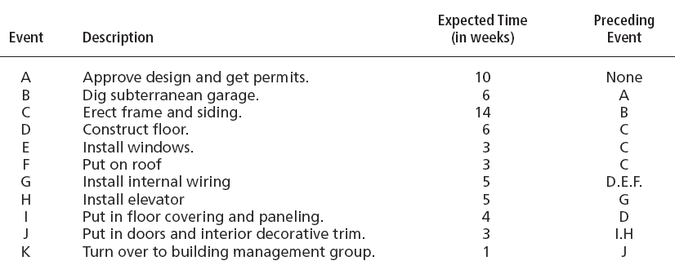
Exhibit 9–8 Events and Activities in Constructing an Office Building

Slide 23
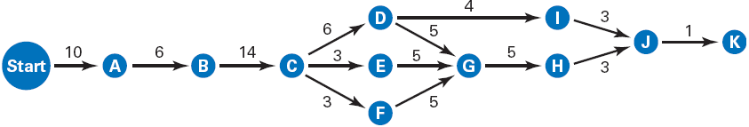
Exhibit 9–9 A Visual PERT Network for Constructing an Office Building
Critical Path: A - B - C - D - G - H - J - K

Slide 24

Allocating Resources: Analysis (cont’d)
Breakeven Analysis
  Is used to determine the point at which all fixed costs have been recovered and profitability begins.
    Fixed cost (FC)
    Variable costs (VC)
    Total Fixed Costs (TFC)
    Price (P)
The Break-even Formula:

Slide 25
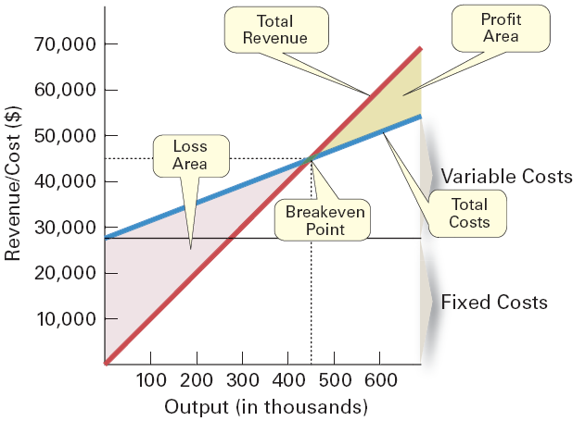
Exhibit 9–10 Breakeven Analysis

Slide 26

Allocating Resources: Analysis (cont’d)
Linear Programming
  A technique that seeks to solve resource allocation problems using the proportional relationships between two variables.

Slide 27
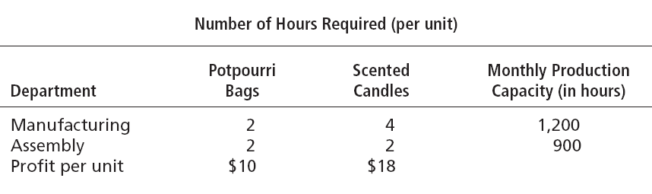
Exhibit 9–11 Production Data for Cinnamon-Scented Products

Slide 28
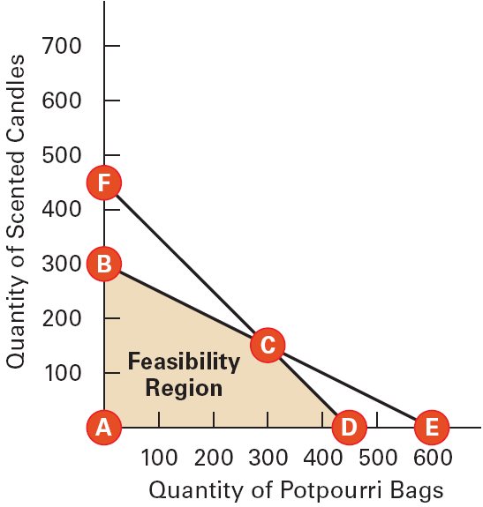
Exhibit 9–12 Graphical Solution to Linear Programming Problem
Max. Assembly
Max. Manufacturing
Max. Profits
Max. Assembly
Max. Manufacturing

Slide 29
Contemporary Planning Techniques
Project
  A one-time-only set of activities that has a definite beginning and ending point time.
Project Management
  The task of getting a project’s activities done on time, within budget, and according to specifications.
    Define project goals
    Identify all required activities, materials, and labor
    Determine the sequence of completion

Slide 30
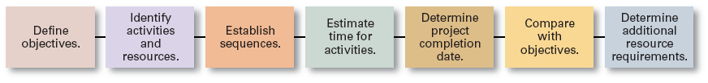
Exhibit 9–13 Project Planning Process
Source: Based on R.S. Russell and B.W. Taylor III, Production and Operations Management (Upper Saddle River, NJ: Prentice Hall, 1995), p. 287.

Slide 31
Contemporary Planning Techniques (cont’d)
Scenario
  A consistent view of what the future is likely to be.
Scenario Planning
  An attempt not try to predict the future but to reduce uncertainty by playing out potential situations under different specified conditions.
Contingency Planning
  Developing scenarios that allow managers determine in advance what their actions should be should a considered event actually occur.

Slide 32
Exhibit 9–14 Preparing for Unexpected Events
Identify potential unexpected events.
Determine if any of these events would have early indicators.
Set up an information gathering system to identify early indicators.
Have appropriate responses (plans) in place if these unexpected events occur.
Source: S. Caudron, “Frontview Mirror,” Business Finance, December 1999, pp. 24–30.

Slide 33
Terms to Know
environmental scanning
competitor intelligence
forecasts
quantitative forecasting
qualitative forecasting
benchmarking
resources
budget
scheduling
Gantt chart
load chart
PERT network
events
activities
slack time
critical path
breakeven analysis
linear programming
project
project management
scenario

